Slide 1
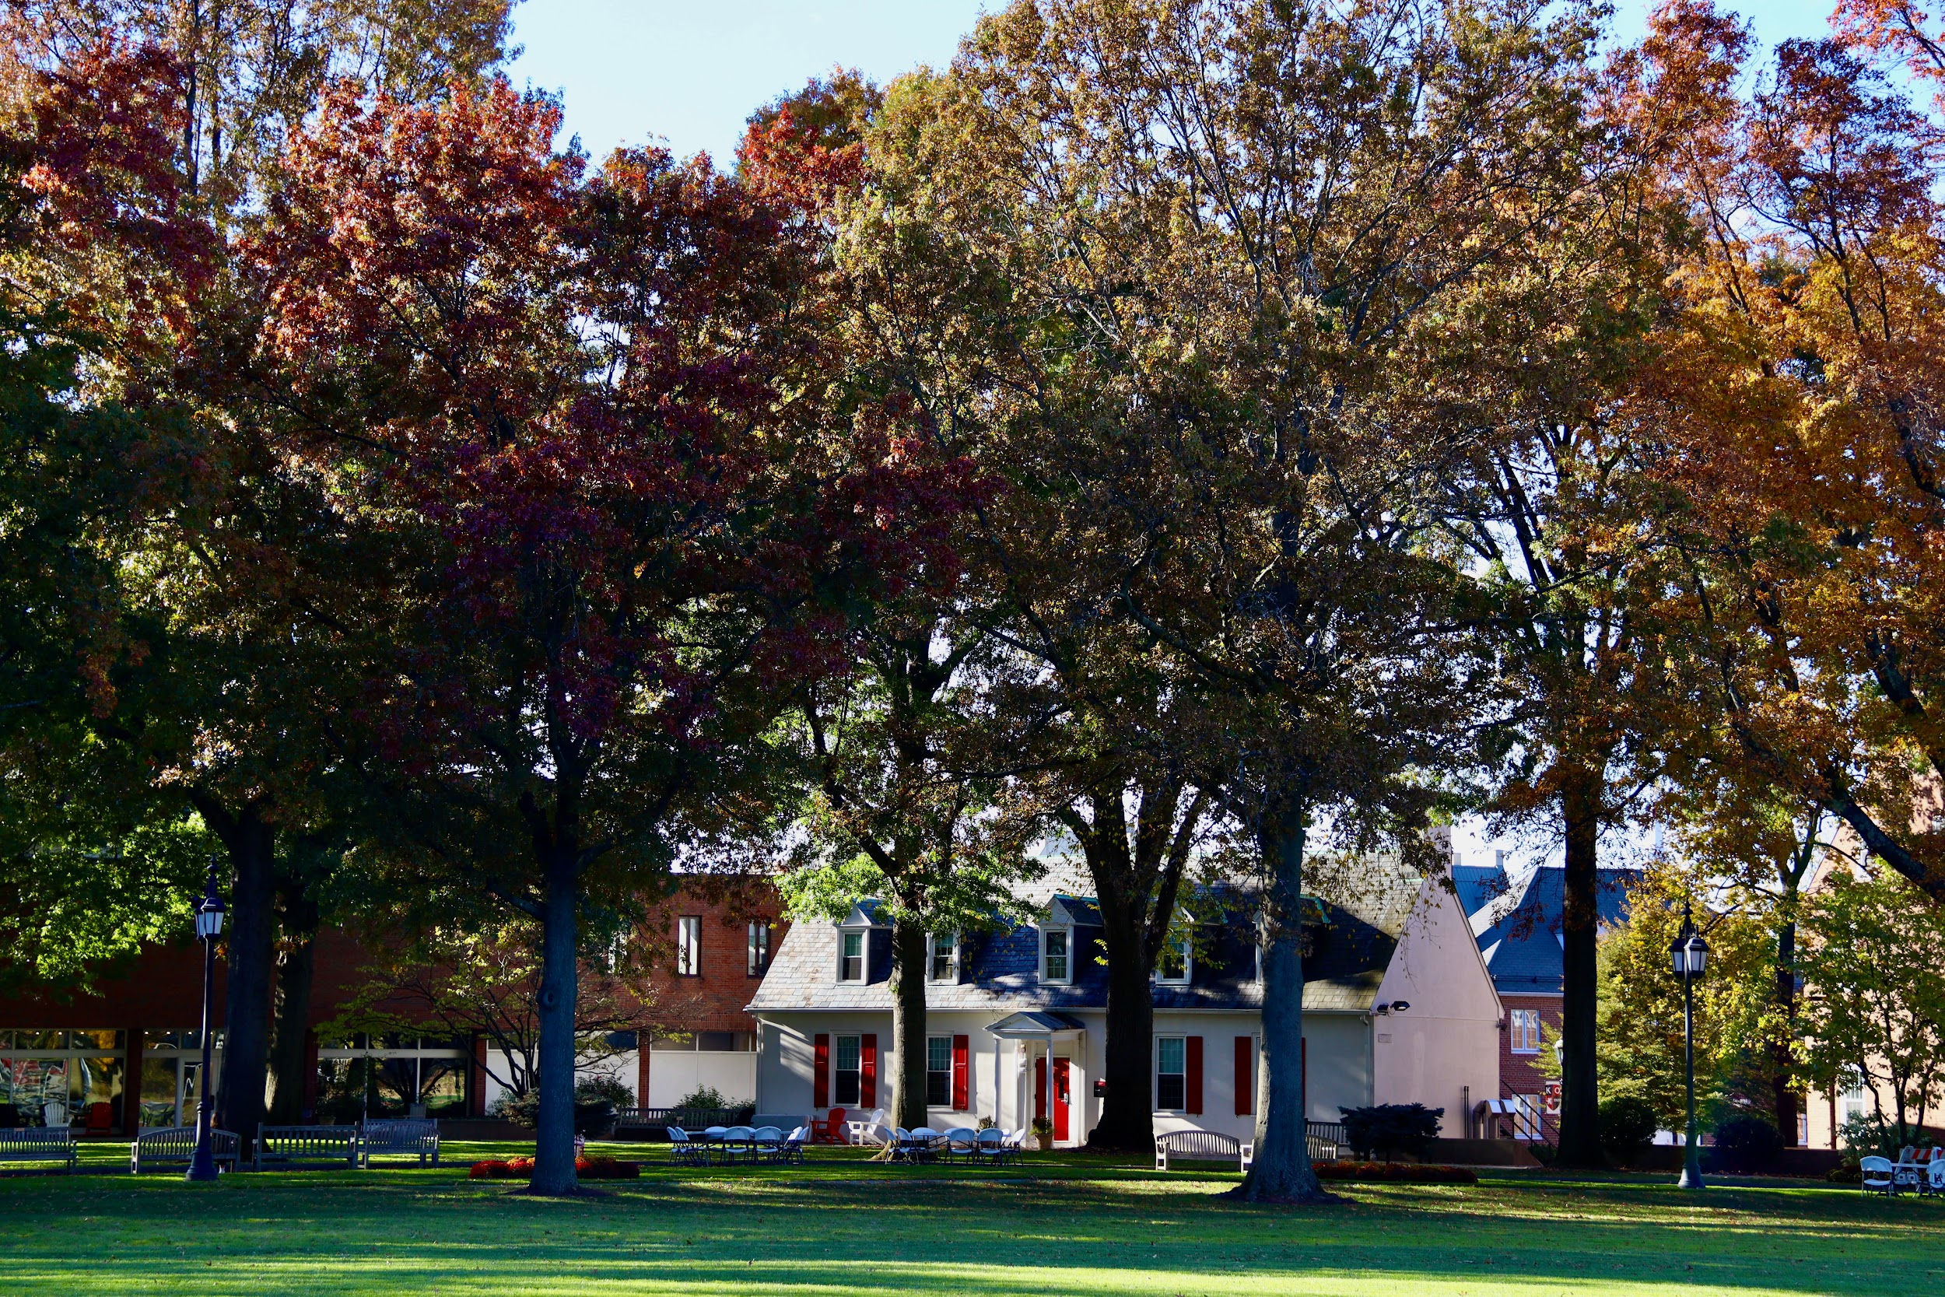
KINGSWOOD OXFORD
New Student Orientation
Lisa Loeb, Head of the Upper School
Kata Baker, Dean of Students
Carolyn McKee, Director of Academic Planning

Slide 2

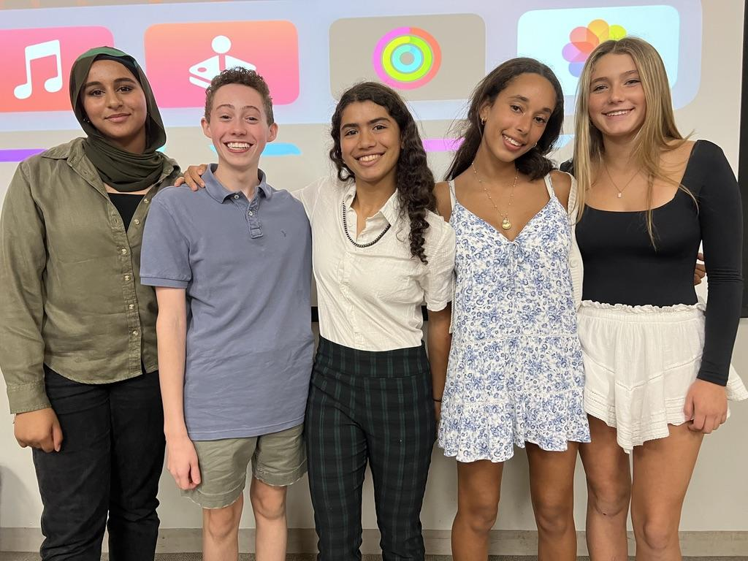

Welcome to KO!
Mrs. Lisa Loeb
Kingswood Oxford inspires students
to excel and lead lives of integrity and involvement by nourishing their talents in a community of
teachers, friends and families.

Slide 3
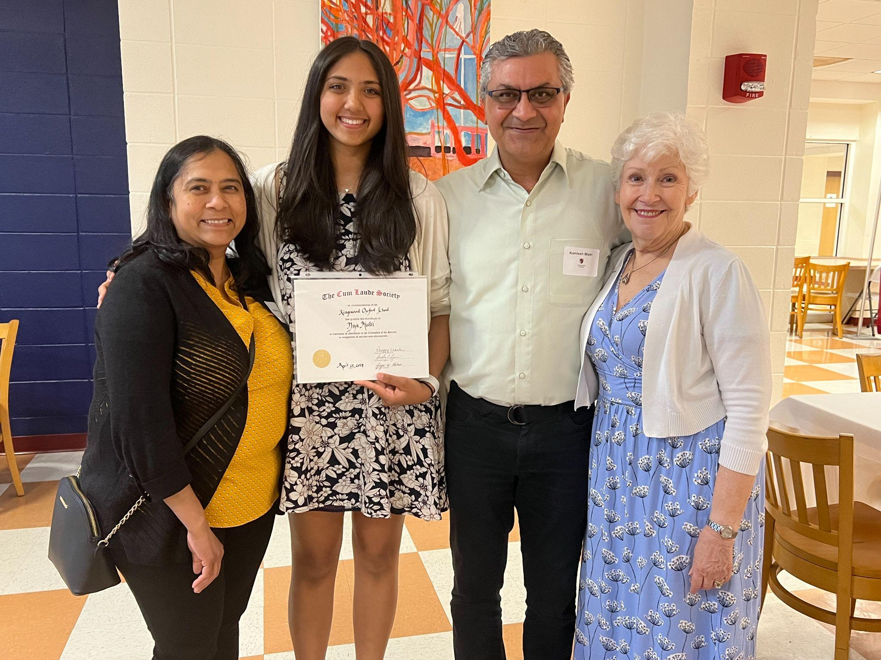
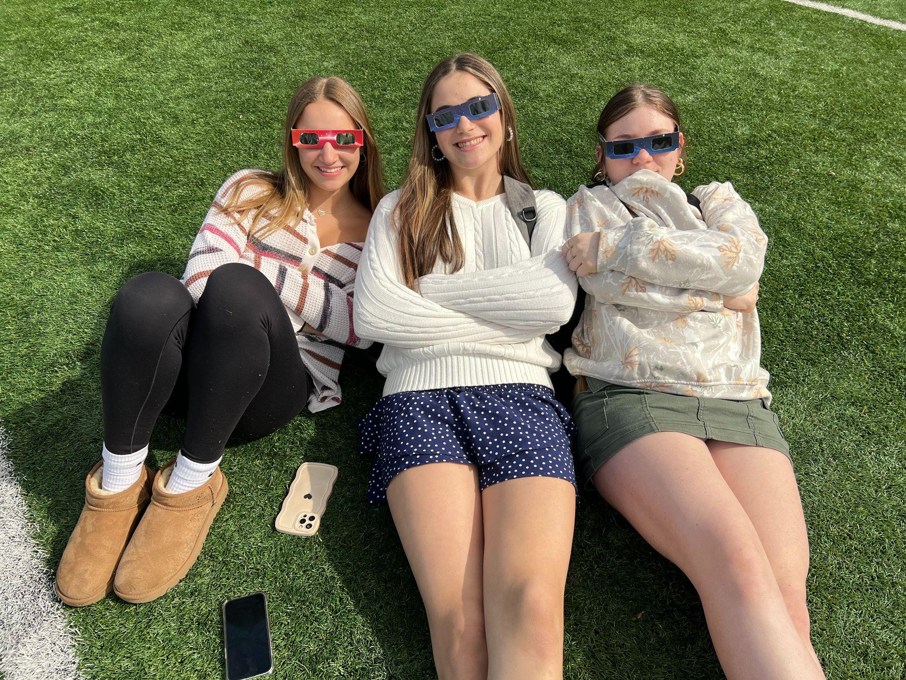
You’re a Wyvern now!
Mrs. Kata Baker
OVERVIEW
Advising
Student Support & Wellness
Clubs & Leadership

Slide 4
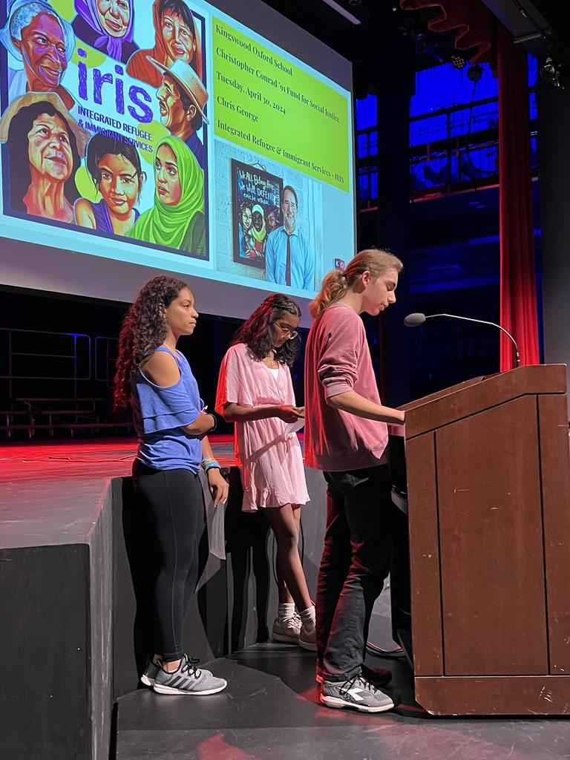
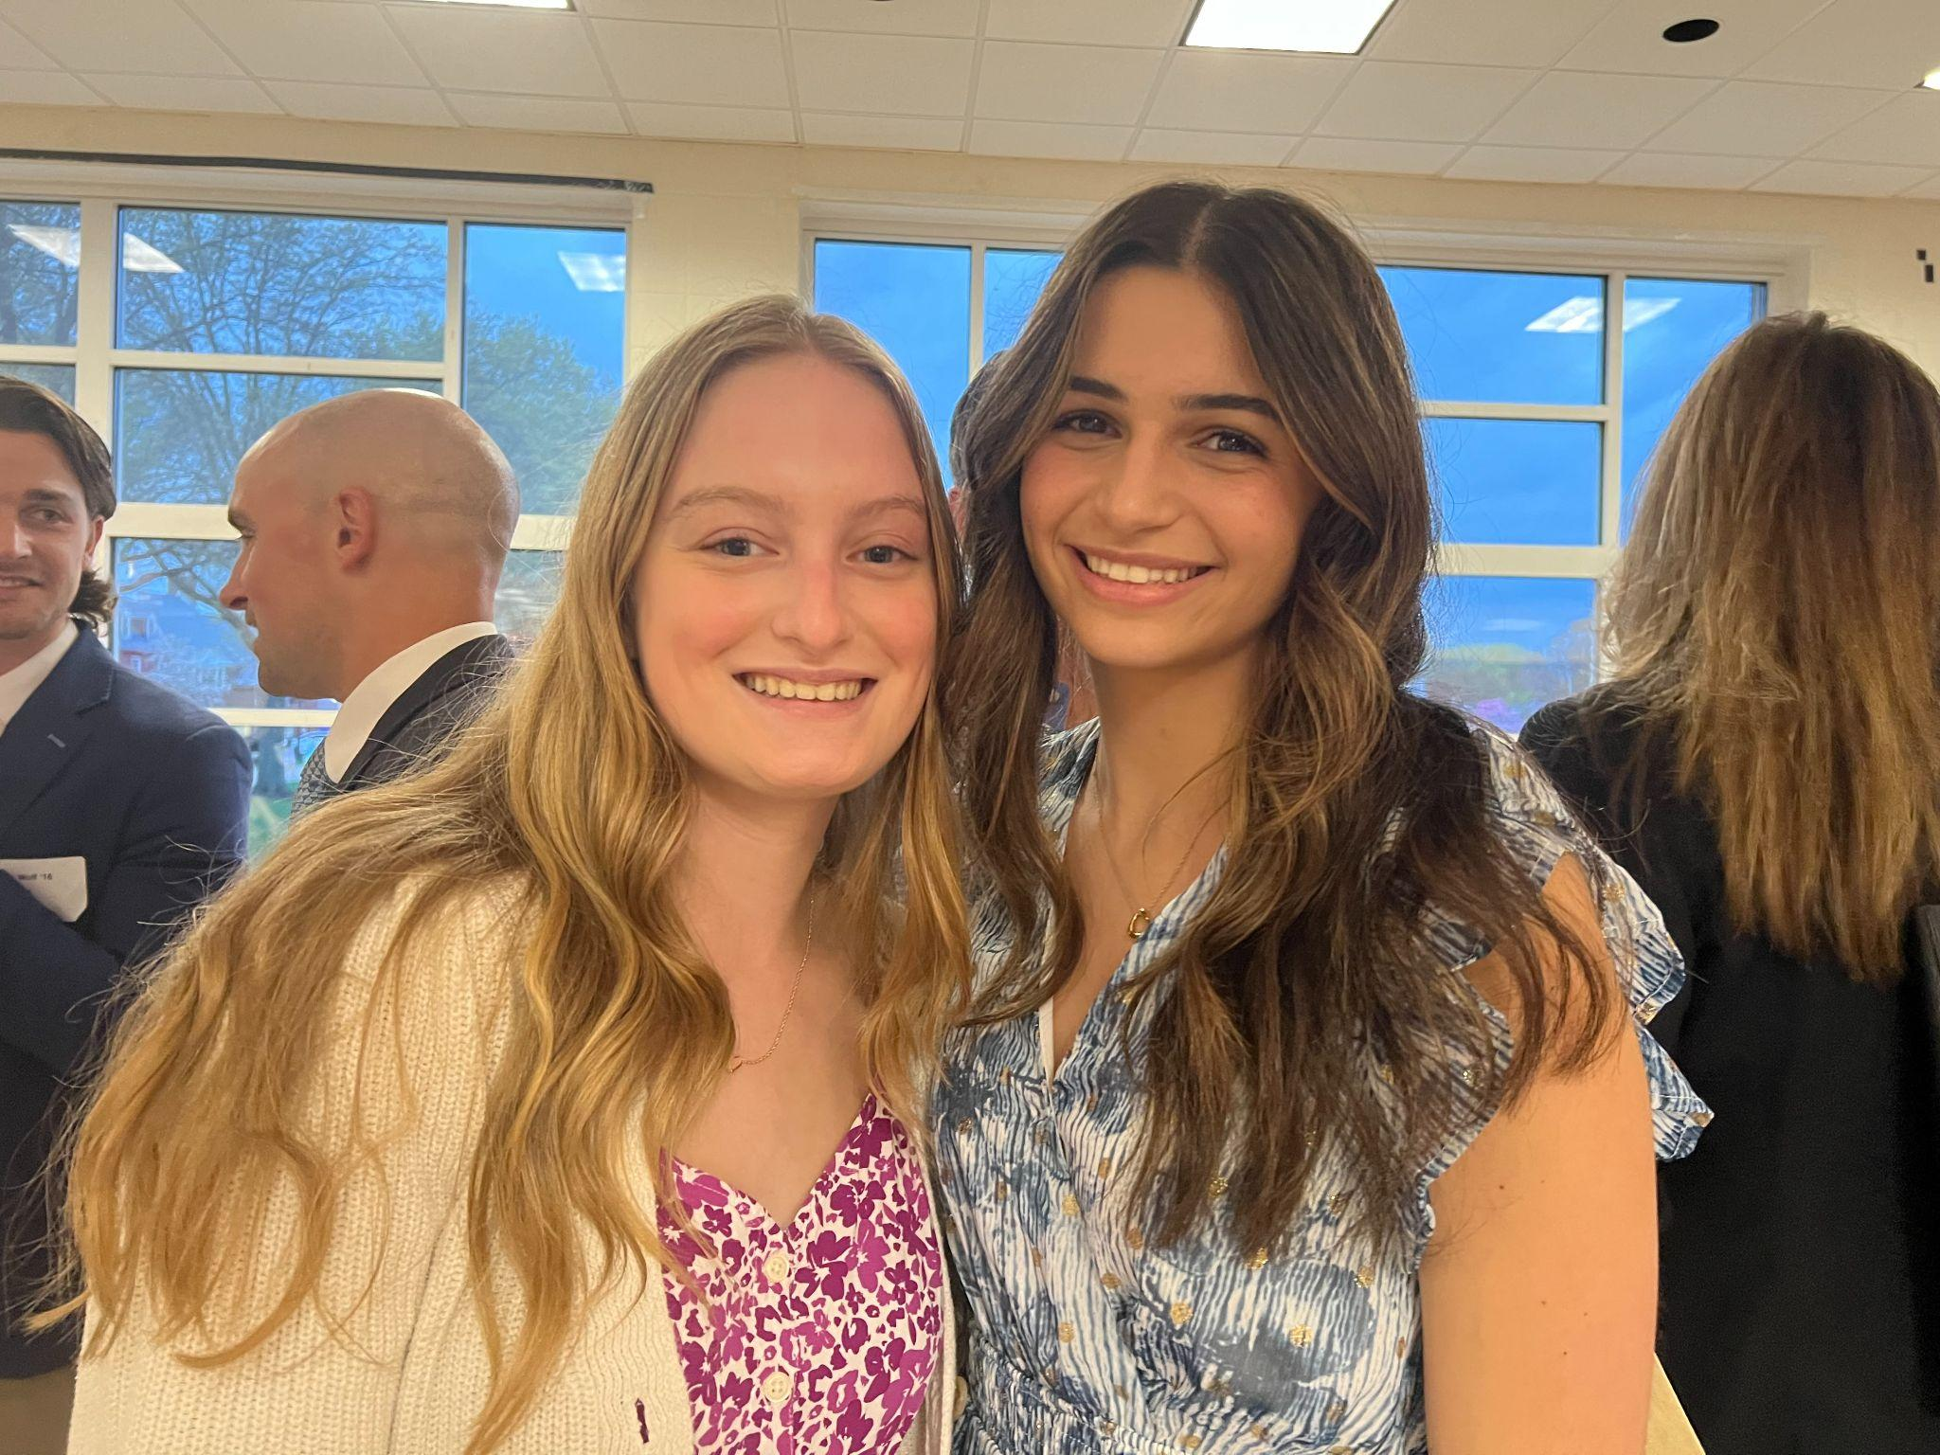
Ms. Carolyn McKee
OVERVIEW
Academic Planning
Placement
Course Registration
Next steps …
July and August

Slide 5
A Day in the Life of a Wyvern
Trish Watson, Form 3 Dean
Alexa Tzanova, Form 4 Dean
Matt Waldman, Form 5 Dean
Lindsay Perkins, US Administrative Coordinator
Josh Balabuch, Director of Athletics
Kyle Reynolds, Director of Theater and Dance

Slide 6

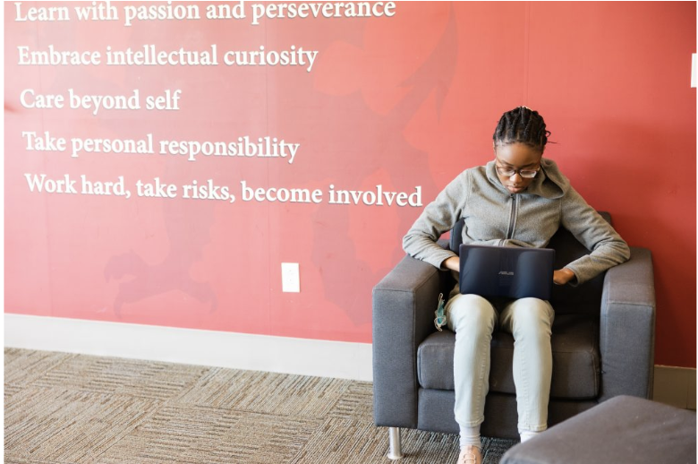

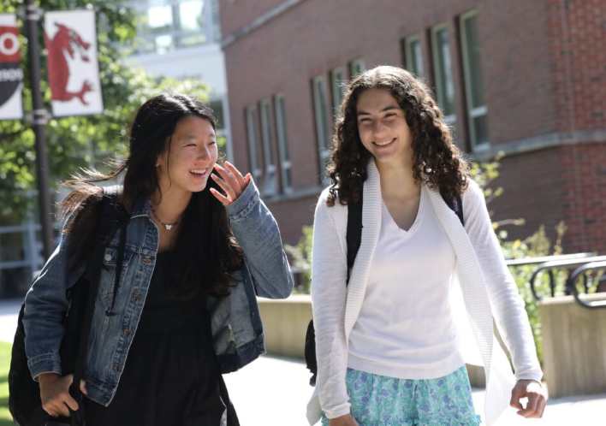
Our Core Values
Demonstrate honesty, integrity and respect
Learn with passion and perseverance
Embrace intellectual curiosity
Care beyond self
Take personal responsibility
Work hard, take risks, become involved
Notes:
Mention US Community Handbook, which we will read and sign off on in September and review periodically throughout the year. We aspire to these values, and they inform our Principles of Community (Respect for Others, Academic Integrity, Acceptable Use Policy). All our programming (academic, advising, service learning, leadership, cocurricular) is designed to support and reinforce these values. Number one priority is the safety, well being and sense of belonging of our students and these values and our POC “rules” are designed to reinforce those priorities.

Slide 7
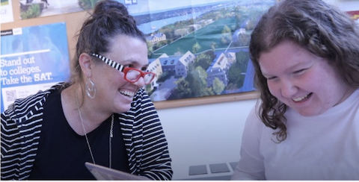
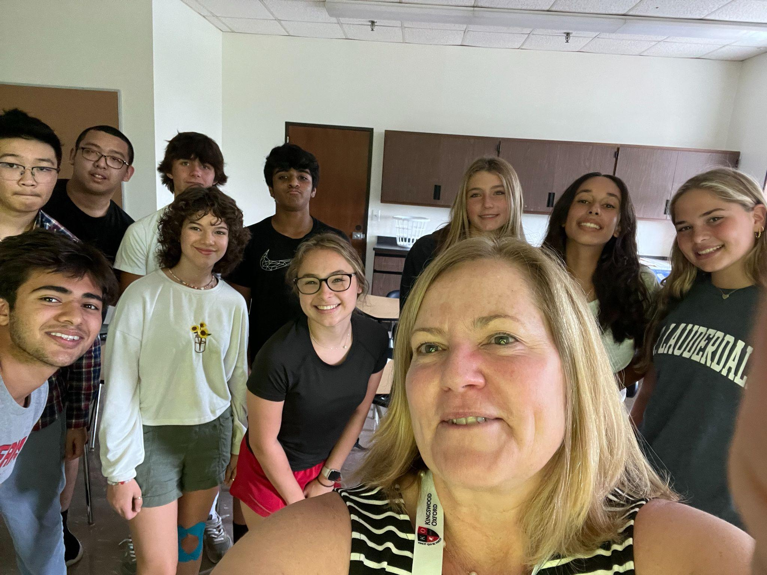
Advising at KO
Your primary/first contact with school
Oversee academic and affective life of your child & partners with you in support of your child
Communication
November & April Midsemester Conferences (led by student)
By email, phone as needed
At drop off line, on the sidelines of games
Thoughtful & Intentional Placement
Form deans will speak more about this later this
morning

Slide 8
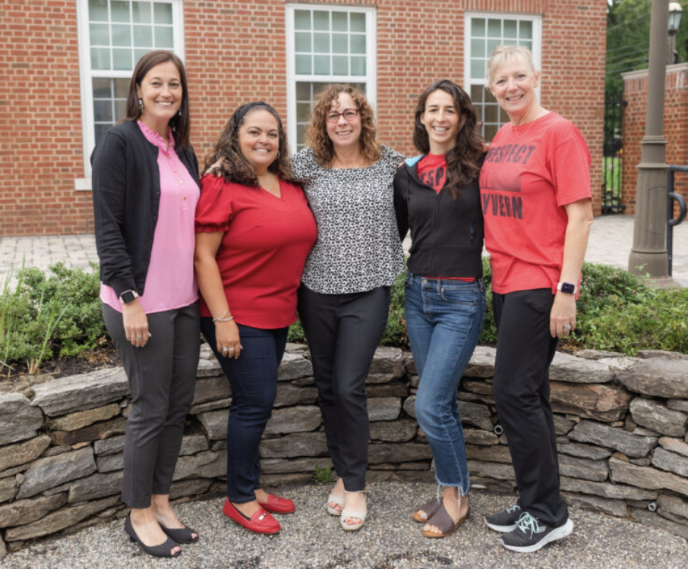
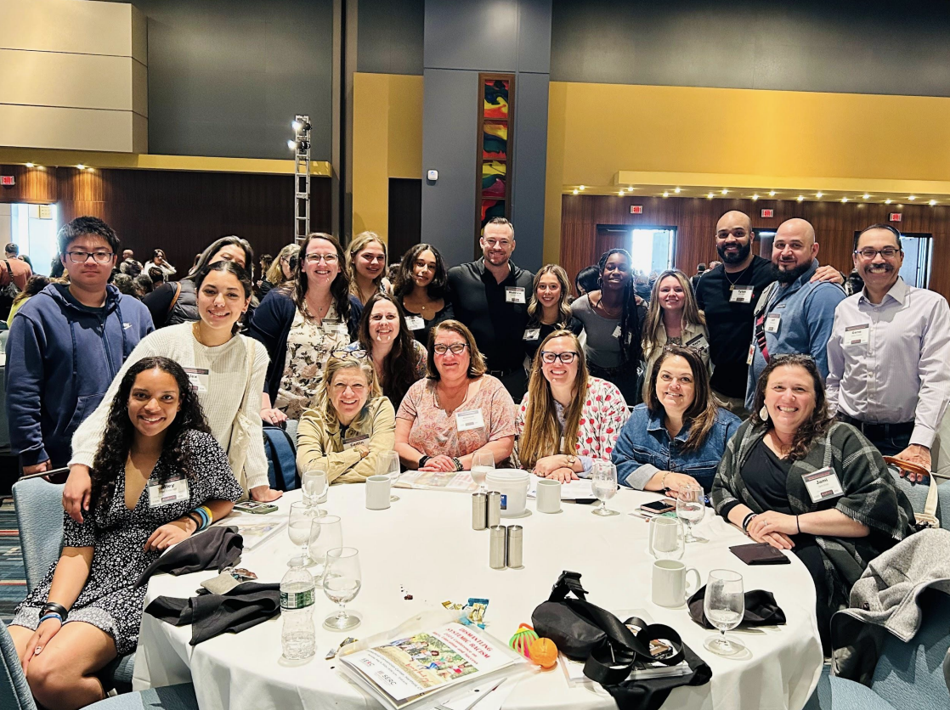
Student Support & Wellness
The Wellness Team
Director of Wellness & Form 4-6 Learning Specialist, Form 3 Learning Specialist, Upper School Mental Health Counselor & School Nurse
Available to all students and families
Teach Form 3 Wyvern Wellness Course (more on this later)
The Diversity, Equity, Inclusion & Belonging (DEIB) Team
5 Faculty/Staff members who have worked together past 2 years and
will work with new Director of DEIB beginning next year
Available to all students and families.
Hold office hours for students, lead affinity groups, develop
programming, support admin & faculty

Slide 9
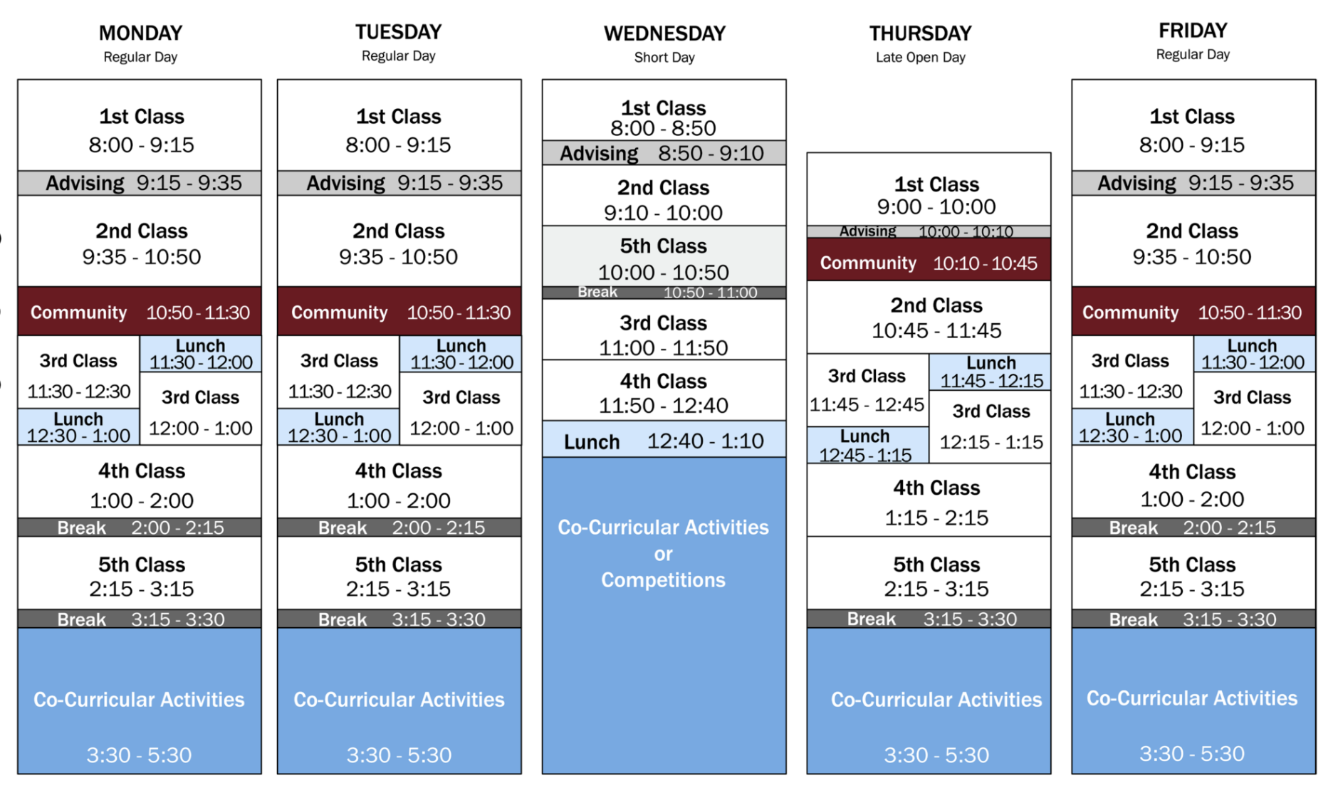
The Daily Schedule
Campus Hours & Attendance
8 Rotating Periods (Typical “Load” is 6 classes, 2 “Free” or Study Hall Periods)
Short Wednesdays/Late Start Thursdays
Breaks (Advising, Community Time, 15 min PM breaks)

Slide 10
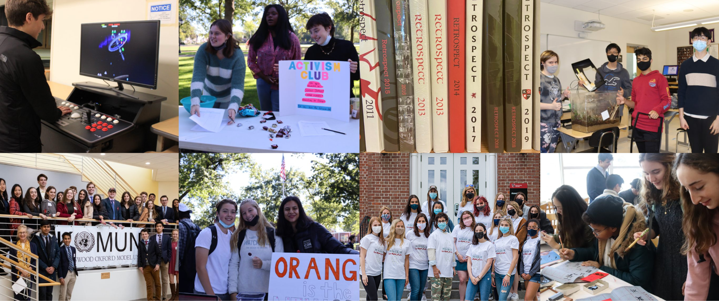
Community Time Programs
Monday & Tuesday Club Programs (Opt in)
Lead by trained student leaders and their faculty advisors
Meet weekly of every other week
Thursday Wyvern Skills Courses (Mandatory)
Form 3 Wyvern Wellness
Form 4 Lead & Learn
(Form 5 College Counseling)
Form 6 Seminar Series
Friday Leadership Programs (Mix of Opt in/Mandatory)
Leadership Trainings (Club Leaders, Sports Captains, Prefect & Senior Advisor, Power of Woman “Buddies”)
Leadership Council Programming
Student Government & Upper School Advisory Council Meetings
Service Learning Programs (60 Hour Graduation Requirement)

Slide 11
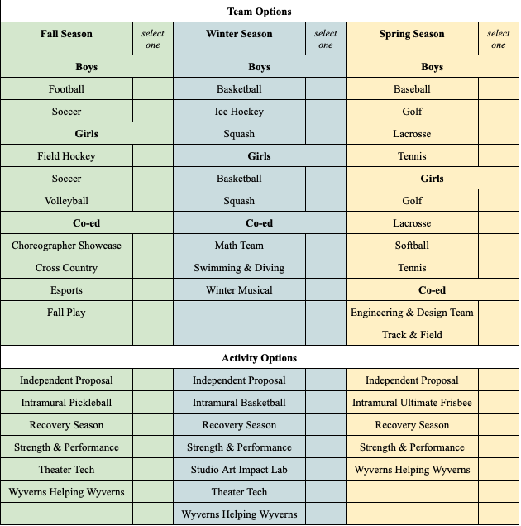
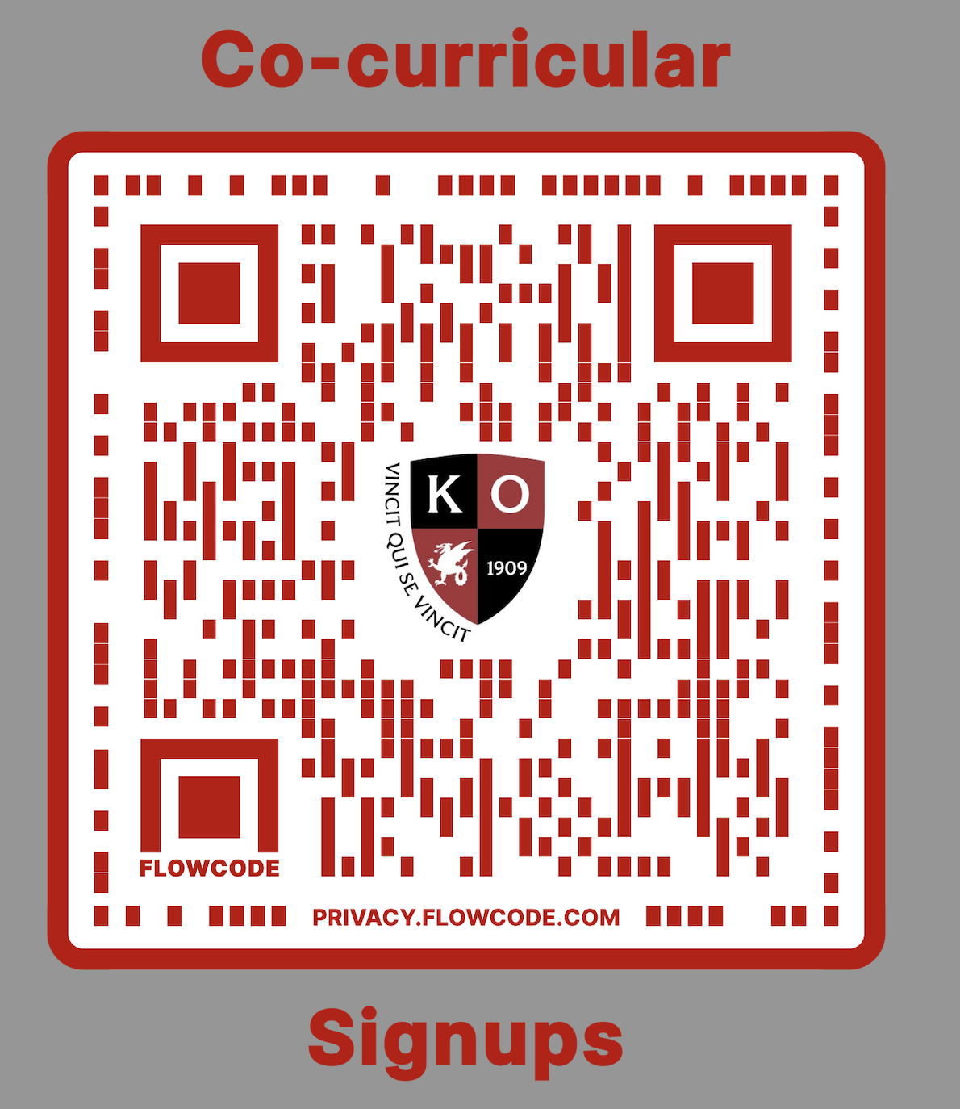
Co-Curricular Program
Integral extension to the academic day
Supports student health and wellness, sense of belonging and school spirit!
Graduation Requirements
Form 3: At least 2 teams, one must be fall season
Form 4: At least 2 teams
Form 5-6: At least 1 team
QR Code to sign up & form available later this morning

Slide 12
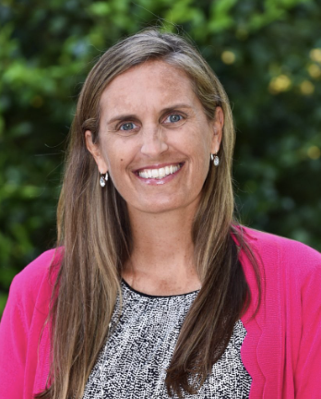
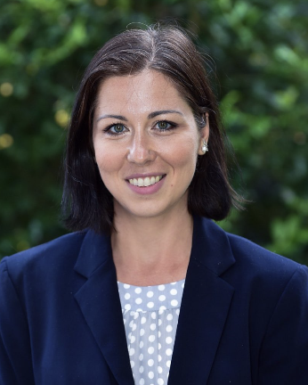
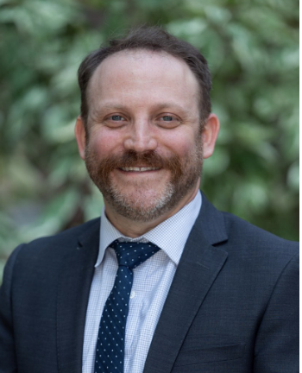
Time with your student’s Form Dean!
Topics you might discuss:
How students are placed with advisors
Transportation (Busing, Parking)
Dress Code
Summer communication plan
Form 3 Trip Details
Orientation Day Details
Mrs. Tricia Watson Dr. Alexa Tzanova Mr. Matt Waldman
Form 3 Dean Form 4 Dean Form 5 Dean

Slide 13
Summer Communication
Already (Please check your email!)
Email with instructions for how to log in to Blackbaud’s parent portal.
Mid June
Email announcing “roll-over” of Blackbaud to new academic year. Please log in to see required summer forms.
Form 3 Families can expect a letter from Mrs. Watson about our Form 3 overnight trip occurring on Sept 4-6th
Early July
Large email containing: 2024-2025 Key Dates, Student Gmail access, Information about all required health, athletic and school forms, Transportation Information, “New Student Guide to Upper School”, Preseason Calendar & Summer Reading & Math Packet Work
Early August
Large email containing: Welcome Letter from Mrs. Loeb & Ms. Baker & Orientation Letters from Form Deans, Directions on how students can access their schedules on Blackbaud
Form 3 Trip Permission slips/deposits due

Slide 14

Form 3 Trip: Sept 4-6, 2024

Slide 15
Please reach out!
The form deans would love to receive an email from each family telling us about their student to help us make thoughtful advising placements.
Please also contact Jackie Rubin, Director of Wellness if you have question about academic or mental health support.
Send emails to:
Form 3 - Trish Watson (watson.t@kingswoodoxford.org)
Form 4 - Alexa Tzanova (tzanova.a@kingswoodoxford.org)
Form 5 - Matt Waldman (waldman.m@kingswoodoxford.org)
Director of Wellness - Jackie Rubin (rubin.j@kingswoodoxford.org)

Slide 16


KO & Company (school store) is open from 11-2 today!

Slide 17
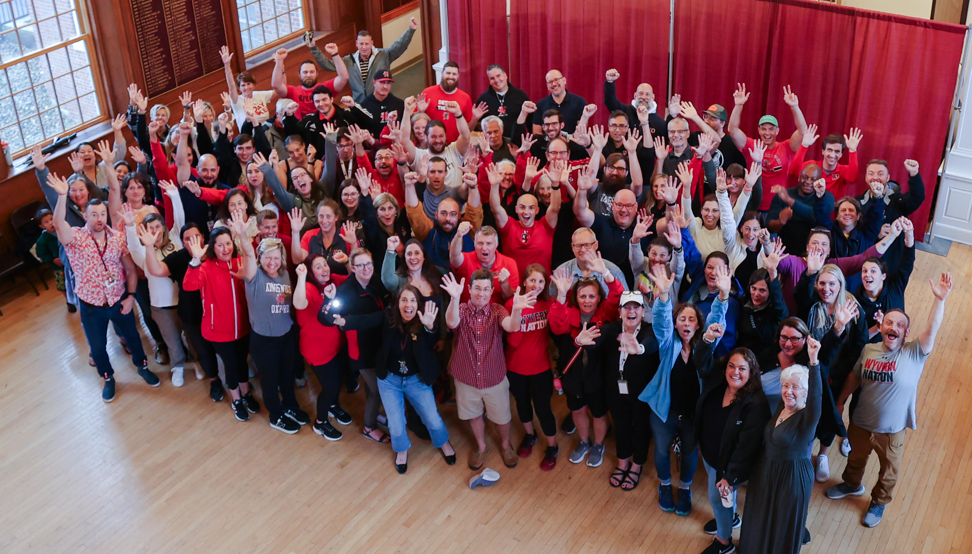
OUR PEOPLE
We can’t wait for you to join us in Wyvern Nation!

